Slide 1
Introduction
C is a general purpose language which is very closely associated with UNIX for which it was developed in Bell Laboratories.
Most of the programs of UNIX are written and run with the help of 'C'.
Many of the important ideas of 'c' stem are from BCPL by Martin Richards.
In 1972, Dennies Ritchie at Bell Laboratories wrote C Language which caused a revolution in computing world .
From beginning C was intended to be useful for busy programmers to get things done easily because C is powerful, dominant and supple language

Slide 2
Why Name 'C' was given to this language?
Many of the ideas of C language were derived and taken from 'B' language.
BCPL and CPL are previous versions of 'B' language.
As many features came from B it was named as 'C'.

Slide 3
C is a structured programming language C supports functions that enables easy maintainability of code, by breaking large file into smaller modules
Comments in C provides easy readability
C is a powerful language.
C programs built from
• Variable and type declarations
• Functions
• Statements
• Expressions

Slide 4
Structure Of “C” Programs
Before going and reading the structure of C programs we need to have a basic knowledge of the following:
1.C's Character Set
2.C's Keywords
3.The General Structure of a 'C' Program
4.How To End A Statement
5.Free Format Language
6.Header Files & Library Functions

Slide 5
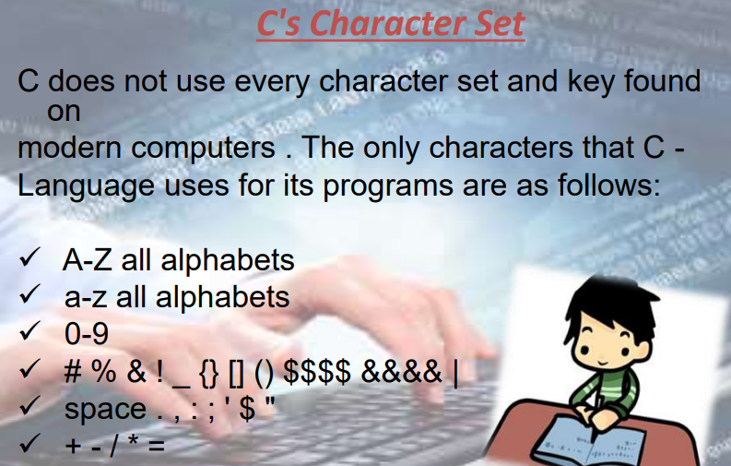

Slide 6
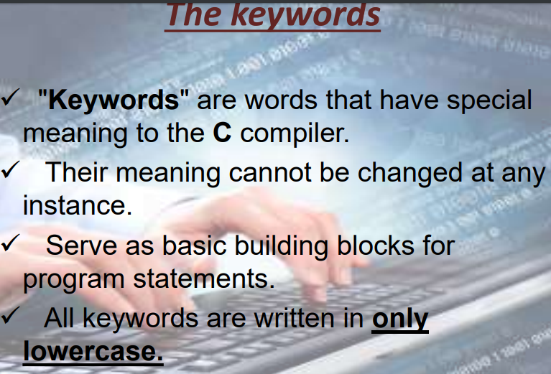

Slide 7
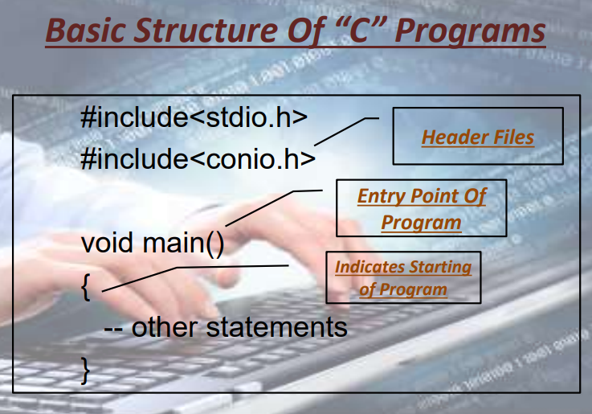

Slide 8
Program structure
A sample C Program
# include<stdio.h>
int main()
{
--other statements
// Comments after double slash
/*
Multiple line comments
*/
}

Slide 9
Header files
• The files that are specified in the include
section is called as header file
• These are precompiled files that has some functions defined in them
• We can call those functions in our
program by supplying parameters
• Header file is given an extension .h
• C Source file is given an extension .c

Slide 10
Main function
This is the entry point of a program
• When a file is executed, the start point is the main function
• From main function the flow goes as per the programmers choice.
• There may or may not be other functions
written by user in a program
• Main function is compulsory for any c program

Slide 11
Writing the first program
#include<stdio.h>
Void main()
{
printf(“Hello”);
}
This program prints Hello on the screen when
we execute it

Slide 12
Running a C Program
• Type a Program
• Save it with filename.c
• Compile the program – This will generate an exe file (executable)
• Run the program (Actually the exe created out of compilation will run and not the .c file)
• In different compiler we have different option for compiling and running. We give only the concepts.

Slide 13
Comments in C
• Single line comment
– // (double slash)
– Termination of comment is by pressing enter key
• Multi line comment
/*….
…….*/
This can span over to multiple lines

Slide 14
Basic Programming using C
Lecture 2

Slide 15
Characteristics of C
It is a middle level language.
It has the simplicity of a high level language as well as the power of low level language.
This aspect of C makes it suitable for writing both application' programs and system programs. Hence it is an excellent, efficient and general-purpose language for most of the application such as mathematical, scientific, business and system software applications.
C is small language, consisting of only 32 English words known as keywords (if, else, for, break etc.)
The power of C is augmented by the library functions provided with it.

Slide 16
Structure of a C Program
C program is a collection of one or more- functions.
Every function is a collection of statements an performs some specific task.

Slide 17
Preprocessor directives are processed through preprocessor before the C source code passes through compiler.
The commonly used pre-processor directives are #include and #define. #include is used for including header files. #define is used to define symbolic constants and macros.
Every C program has one or more functions. If a program has only one function then it must be main().
Execution of every C program starts with main( )function. It has two parts, declaration of local variables and statements. The scope of the local variable is local to that function only.
Statements in the main() function are executed one by one. Other functions are the user-defined functions, which also have local variables and C statements. They can be defined before or after main( ).
It may be possible that some variables have to be used in many functions, so it is necessary to declare them globally. These variables are called global variables

Slide 18
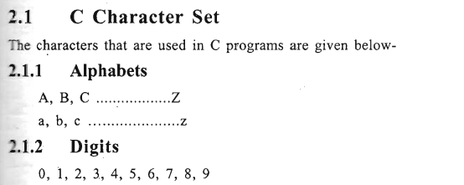
Elements of C

Slide 19
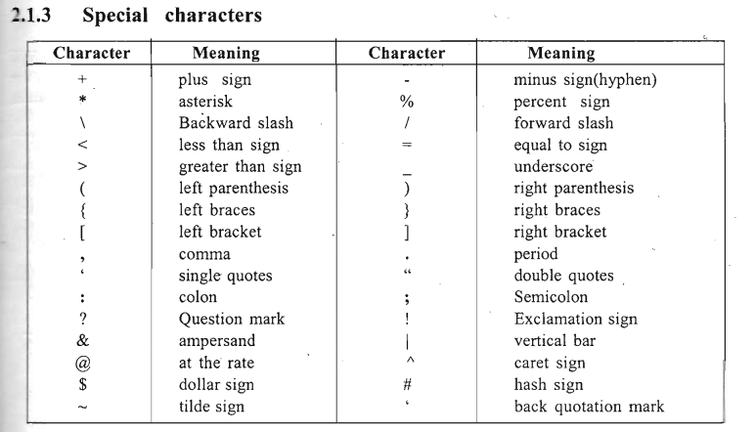

Slide 20
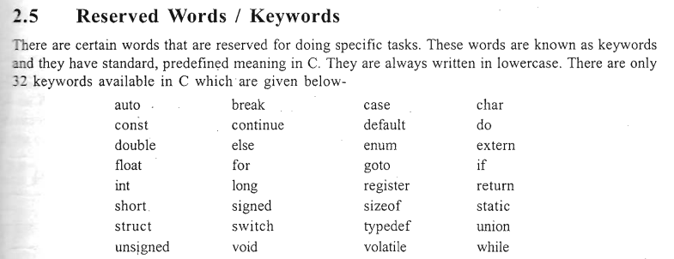

Slide 21
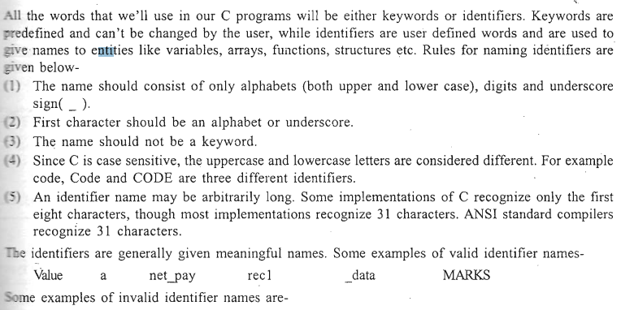
Identifiers
5bc
int
Rec#
avg no

Slide 22
Data Types
C supports different types of data. Storage representation of these data types is different in memory.
There are four fundamental datatypes in C, which are
1.int,
2.char,
3.float and
4. double..

Slide 23
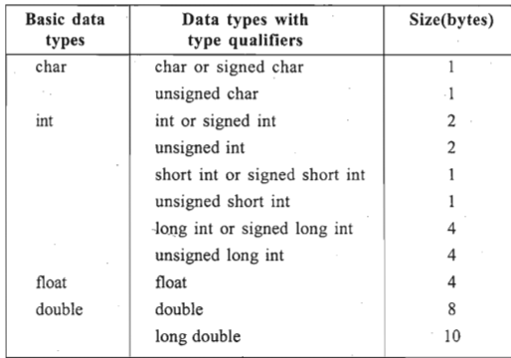

Slide 24
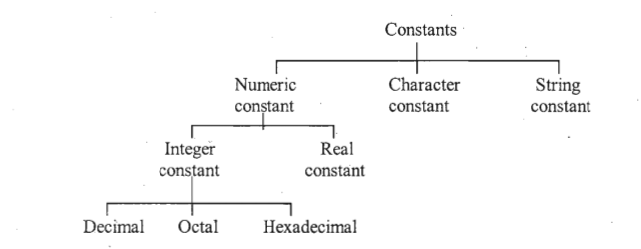
Constants
Constant is a value that cannot be changed during execution of the program

Slide 25
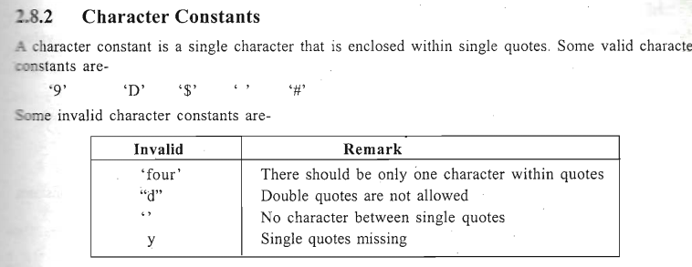
These are some rules for defining numeric constants 1. Numeric constant should have at least one digit. 2. No comma or space is allowed within the numeric constant. " 3. Numeric constants can either be positive or negative but default sign is always positive
Integer constant : Integer constants are whole numbers which have no decimal point ( . )
Real (floating point) Constants : Floating point constants are numeric constants that contain decimal point

Slide 26
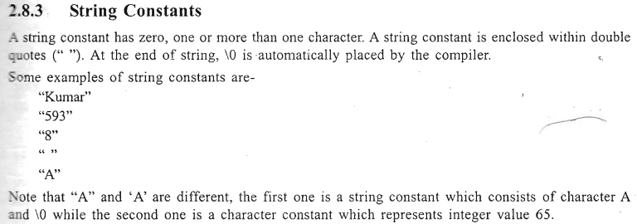

Slide 27
Variables
Variable is a name that can be -used to store values.
Variables can take different values but one at a time. These values can be changed during execution of the program.
A data type is associated with each variable. The data type of the variable decides what values it can take.
The rules for naming variables are same as that for naming identifiers

Slide 28
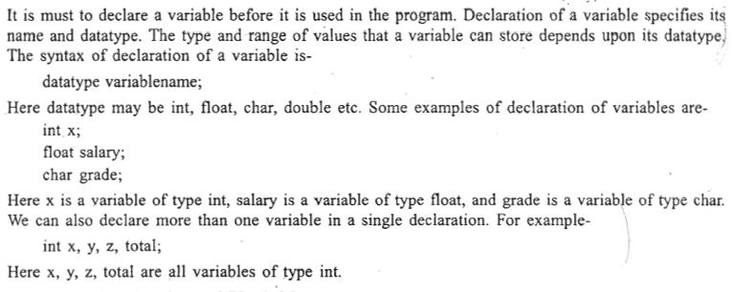
Declaration of Variables

Slide 29
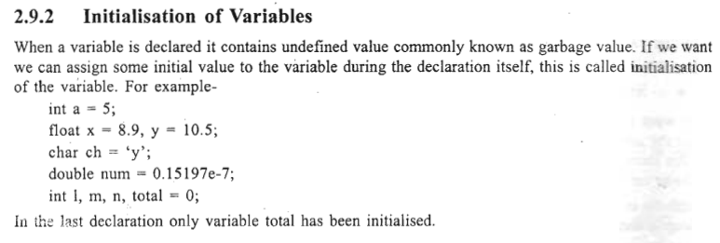

Slide 30
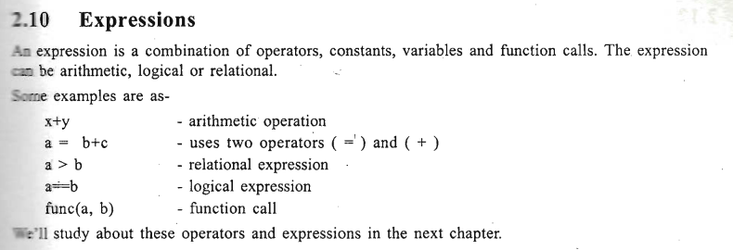

Slide 31
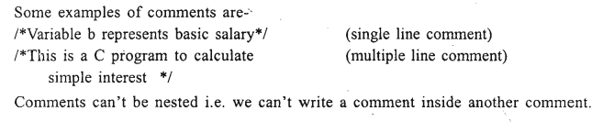
Comments
Comments are used for increasing readability of the program.
They explain the purpose of the program and are helpful in understanding the program.
Comments are written inside /* and */.
There can be single line or multiple line comments.

Slide 32
Input-Output In C
The input output is performed through a set of library functions that are supplied with every C compiler.
These functions are formally not a part of the language but they are considered standard for all input-output ions in C.
The set of library functions that performs input-output operations is known as standard library
There are several header files that provide necessary information in support of the various library functions.
header files are entered in the program using the #include directive at the beginning of the program.
example if a program uses any function from the standard I/O library, then it should include the file stdio.h as-
#include<stdio.h>

Slide 33
Input-Output In C
we'll discuss about the input functions scanf( ) and getchar( ) and the output functions printf() and putchar( )
A simple method for taking the data as input is to give the value to the variables by assignment statement. For Example- .
int basic = 2000;
Char ch = 'y';

Slide 34
The second method is to use the input function scanf( ), which takes the input data from the keyboard.
In this method we can give any value to the variables at run time. For output, we use the printf () function.

Slide 35
Conversion Specifications
The functions scanf( ) and printf( ) make use of conversion specifications to specify the type and size
Each conversion specification must begin with a percent sign ( % ). Some conversion specification given below

Slide 36
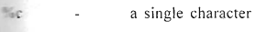
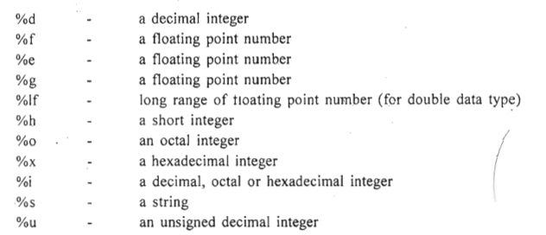

Slide 37
Reading Input Data
Input data can be entered into the memory from a standard input device (keyboard).
C provides the scanf( ) library function for entering input data.
This function can take all types of values (numeric, character, string) as input.
The scanf( ) function can be written as
scanf( "Conversion Specifications" , address I, address2, ....);

Slide 38
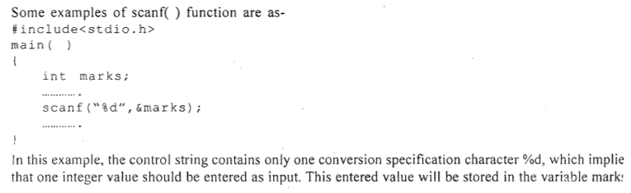

Slide 39
This function should have at least two parameters.
First parameter is a control string, which contains conversion specification characters.
It should be within double quotes. The conversion specification characters may be one or more; it depends on the number of variables we want to input.
The other parameters are addresses of variables.
In the scanf( ) function at least one address should be present
The address of a variable is found by preceding the variable name by an ampersand (&) sign. This sign is called the address operator and it gives the starting address of the variable name in memory.
A string variable is not preceded by & sign to get .the address.

Slide 40
Basic Programming using C
Lecture 3 : Operators And Expressions

Slide 41
Operators And Expressions
1. Arithmetic operators
2. Assignment operators .
3. Increment and Decrement operators
4. Relational operators.
5. Logical operators
6. Conditional operator
7. Comma operator
8. sizeof operator
9. Bitwise operators
10. Other operators

Slide 42
4.1 Arithmetic Operators
Arithmetic operators are used for numeric calculations. They are of two types -
1. Unary arithmetic operators
2. Binary arithmetic operators
4.1.1 Unary Arithmetic Operators
Unary operators require only one operand. For example-
+x -y
Here '-' changes the sign of the operand y.
4.1.2. Binary Arithmetic Operators
Binary operators require two operands. There are five binary arithmetic operators

Slide 43
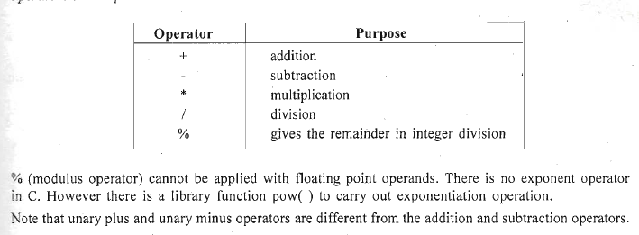

Slide 44
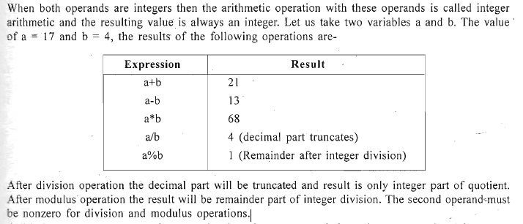
4.2 Integer Arithmetic

Slide 45
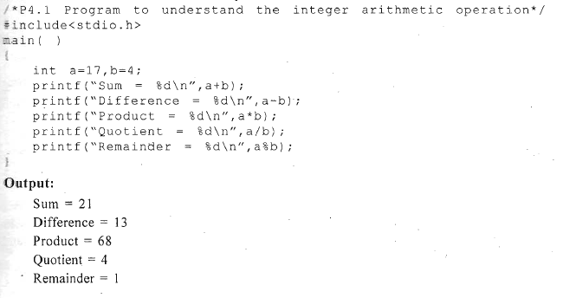

Slide 46
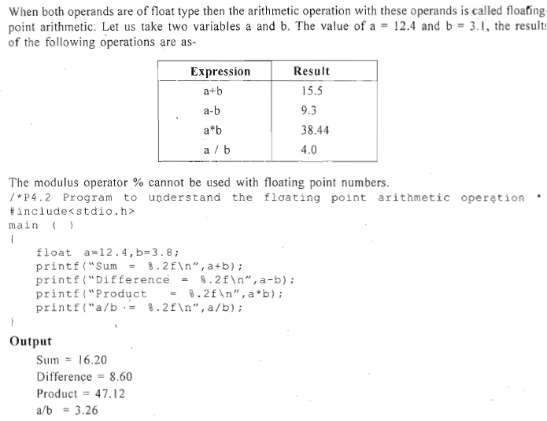
4.3 Floating-Point Arithmetic

Slide 47
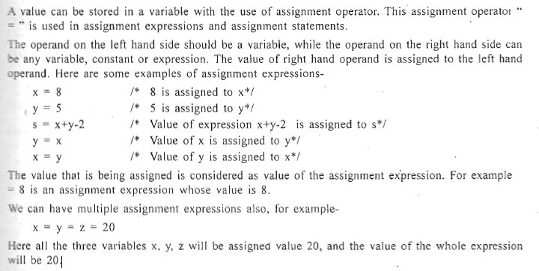
Assignment Operators

Slide 48
Increment And Decrement Operators
C has two useful operators increment ( ++ ) and decrement ( - - ).
These are unary operators because they operate on a single operand.
The increment operator ( ++ ) increments the value of the variable by 1 and decrement operator ( - - ) decrements the value of the variable by 1.

Slide 49
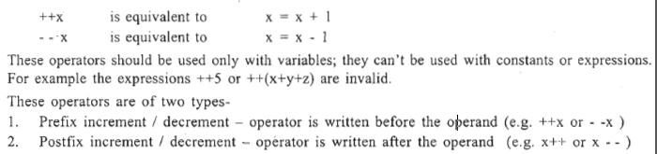

Slide 50
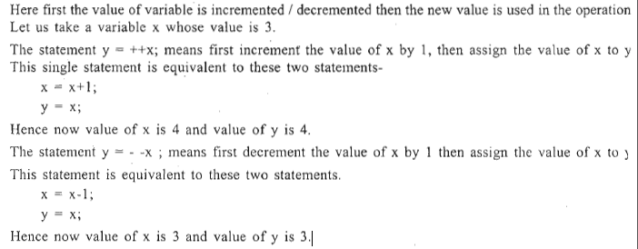
Prefix Increment / Decrement

Slide 51
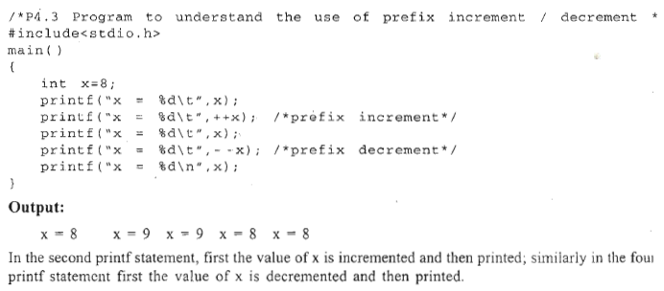
X=8 x=9 x=9 x=8 x=8

Slide 52
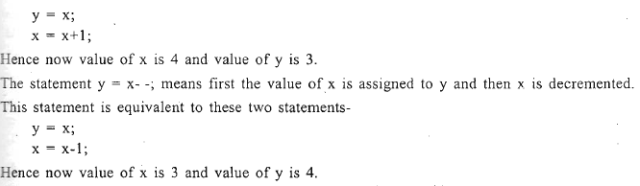
Postfix Increment / Decrement
Here first the value of variable is used in the operation and then increment/decrement is perform
Let us take a variable whose value is x=3.
The statement y = x++; means first the value of x is assigned to y and then x is incremented. The statement is equivalent to these two statements

Slide 53
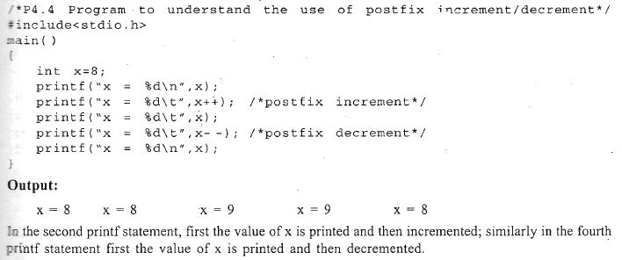
X=8 x=8 x=9 x=9 x=8

Slide 54
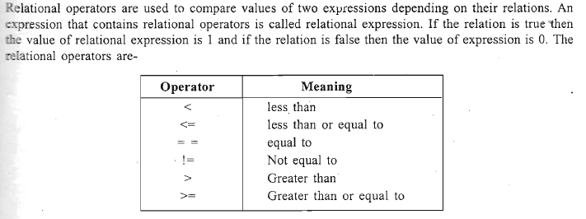
Relational Operators

Slide 55
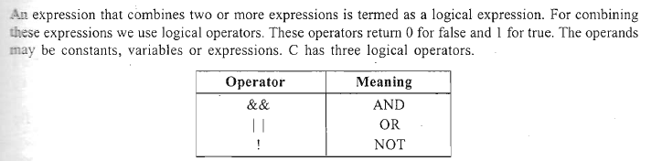
Logical or Boolean Operators

Slide 56
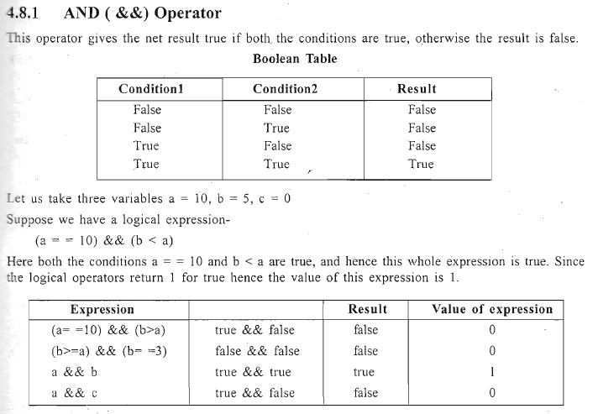

Slide 57
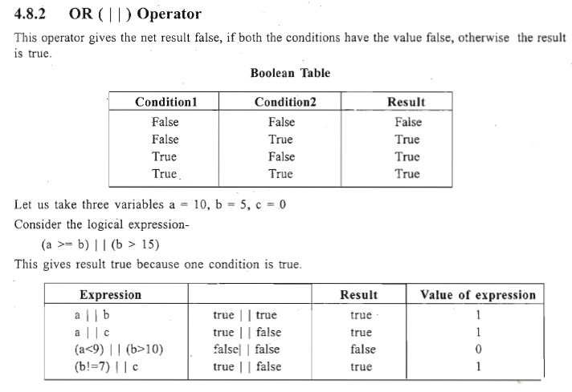

Slide 58
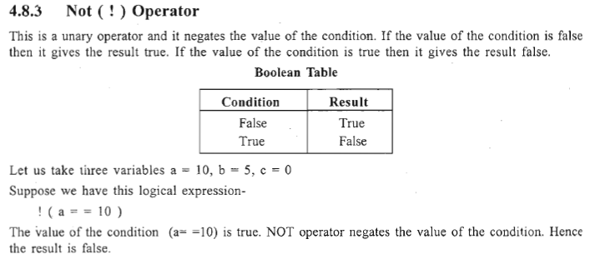

Slide 59
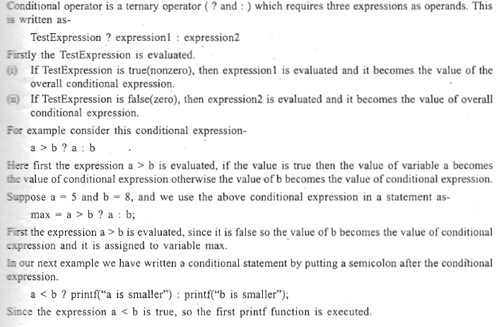
Conditional Operator

Slide 60
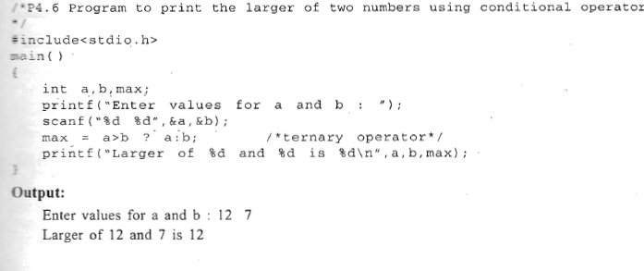

Slide 61
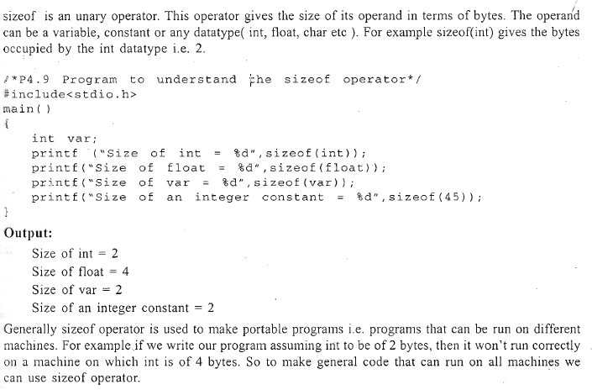
Sizeof Operator

Slide 62
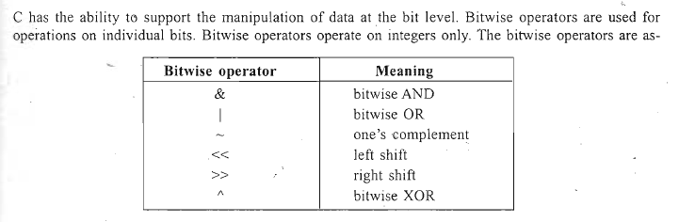
Bitwise Operators
a | b | Y=a^b
0 | 0 | 0
0 | 1 | 1
1 | 0 | 1
1 | 1 | 0

Slide 63
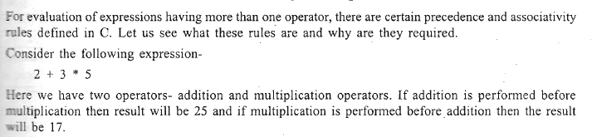
Precedence And Associativity Of Operators

Slide 64
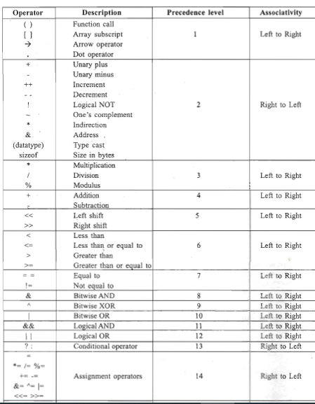

Slide 65
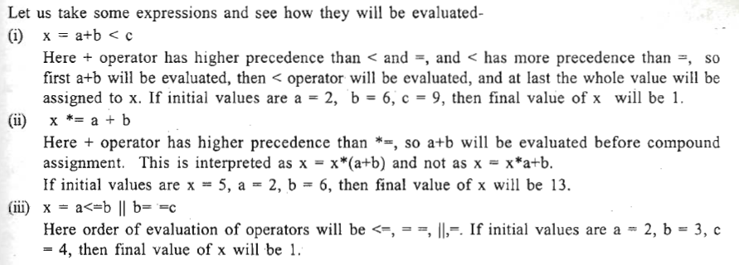

Slide 66
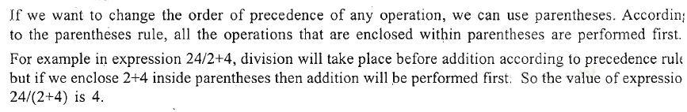
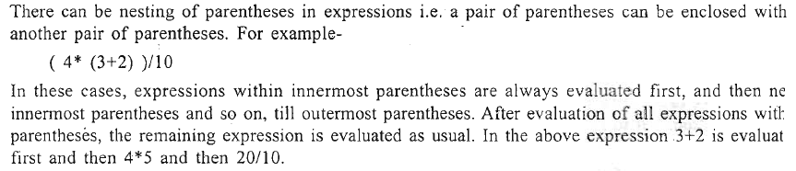
Role Of Parentheses- In Evaluating Expressions

Slide 67
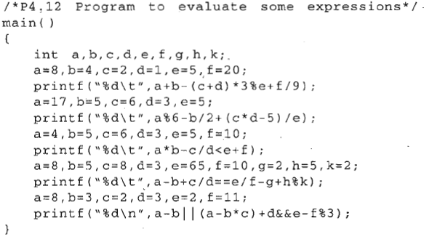

Slide 68
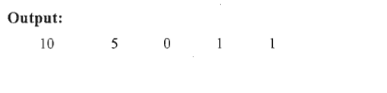

Slide 69
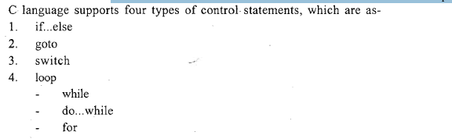
Control Statements
Control statements enable us to specify the order in which the various instructions in the program are to be executed.
Control statements define how the control is transferred to other parts of the program.

Slide 70
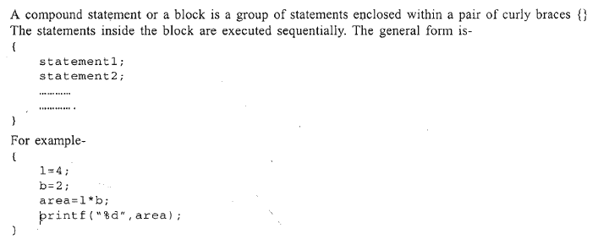
1.1 Compound Statement or Block

Slide 71
if...else
This is a bi-directional conditional control statement. This statement is used to test a condition and take one of the two possible actions.
If the condition is true then a single statement or a block of statements is executed (one part of the program), otherwise another single statement or a block of statements is executed (other part of the program).
Recall that in C, any nonzero value is regarded as true while zero is regarded as false.

Slide 72
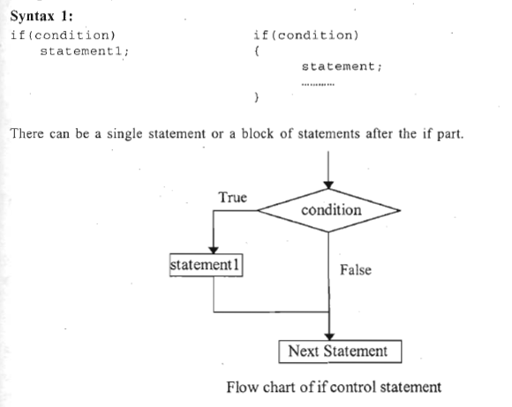
Here if the condition is true(nonzero) then statement! is executed, and if it is false(zero), then the next statement which is immediately after the if control statement is executed.

Slide 73
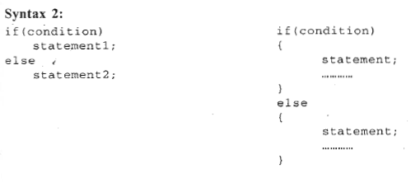
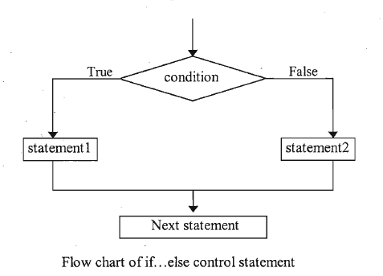
Here if the condition is true then statement1 is executed and if it is false then statement2 is executed. After this the control transfers to the next statement which is immediately after the if. .. else control statement.

Slide 74
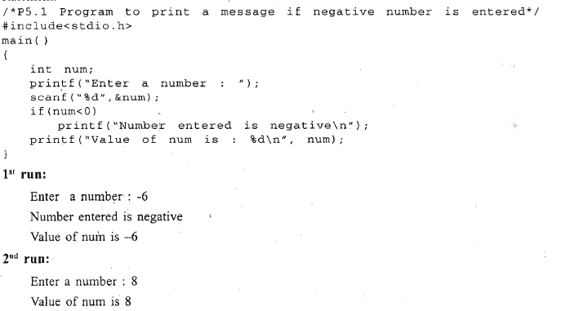

Slide 75



Slide 76


Slide 77

Nesting of if... else
While nesting if...else statements, sometimes confusion may arise in associating else part with appropriate if part

Slide 78


Slide 79


Slide 80


Slide 81


Slide 82


Slide 83



Slide 84

Loops

Slide 85




Slide 86

Note that inside the body of the loop there should be a statement that alters the value of the condition, so that the condition becomes false ultimately at some point.

Slide 87


Slide 88



Slide 89


Slide 90



Slide 91


Slide 92


Slide 93


Slide 94


Slide 95
The do... while loop is generally used for checking validity of entered data.
Suppose we want the user to enter an employee ID, and the valid IDs are in the range 100 to 500 only. If the user enters an invalid ID, we want to ignore that ID and again ask him to enter another one, and we want this process to continue till he enters a valid ID.
In this type of situation we can use do ... while loop.
do
printf("Enter employee ID ");
scanf("%d",&emp_id) ;
}while (emp_id<100 I I emp_id>500 );
This loop will terminate only when the entered number is in the valid range 100 to 500.

Slide 96

for loop
The 'for' statement is very useful while programming in C. It has three expressions and semicolons are used for separating these expressions. The 'for' statement can be written as

Slide 97
Expression 1 is an initialization expression, expression 2 is a test expression or condition and expression3 is an update expression.
expression1 is executed only once when the loop starts and is used to initialize the loop variables.
This expression is generally an assignment expression. expression2 is a condition and is tested before each iteration of the loop.
This condition generally uses relational and logical operators
expression3 is an update expression and is executed each time after the body of the loop is executed.
For(i=0;i<10;i++)

Slide 98
Now let us see how this loop works. Firstly the initialization expression is executed and the loop variables are initialized, and then the condition is checked, if the condition is true then the body of loop is executed.
After ,executing the loop body, control transfers to expression3(update expression) and it modifies the loop variables and then again the condition is checked, and if it is true, the body of loop is executed.
This process continues till the condition is true and when the condition becomes false the loop is terminated and control is transferred to the statement following the loop.
Although the task of while and for loops is same, the for loop is generally used when the number of iterations are known in advance and while loop is used where number of iterations are not known.

Slide 99


Slide 100


Slide 101


Slide 102

A= 2 b=4
1st i=1 i<=4 result=2
i=2 2<=4 result=4
i=3 3<=4 result=4+2=6
i=4 4<=4 result =6+2=8

Slide 103

N=5 i<5 z=0+1=1 x=1 y=1
i=2 i<5 z=2
1 1 2 3 5

Slide 104
All the three expressions of the for loop are optional. We can omit anyone or all the three expressions in the for loop but in any case the two separating semicolons should always be present.
Expression 1 is omitted when the initialization work is done before entering the loop.'
expression2 is a condition and if omitted, it is always assumed to be true and so. this type of loop will never stop executing. This type of loop is infinite and to avoid it there should be a statement inside the loop that takes the control out of the loop.
expression3 is an update expression and is omitted when it is present inside the body of the loop

Slide 106

N=42 rem =2 sum=0+2=2 n=42/10= 4
4>0 rem=4%10=4 sum=2+4=6 n=4/10=0

Slide 107


Slide 108
Nesting of Loops
When a loop is written inside the body of another loop, then it is known as nesting of loops.
Any type of loop can be nested inside any other type of loop. For example a for loop may be nested inside another for loop or inside a while or do while loop.
Similarly while and do while loops can be nested

Slide 109



Slide 110

100 to 999 546
Num
Num=546
Sum=0
% = reminder 546%10=6 d=6 cube=d*d*d sum=sum+cube
546/10 = 54 num=54 54%10 d=4 cube= sum =sum+cube
54/10 = 5 num=5 5%10 = 5 d=5
5/10 =0

Slide 111

371 n=371
D=1
N=37
Cube=d*d*d
Sum=0+1=1

Slide 112

Infinite Loops

Slide 113


Slide 114


Here we wanted the loop to execute till the value of n is equal to 2. So we should have written n= =2 but mistakenly we have written n = 2. Now n = 2 is an assignment expression and the value of this expression is 2, which is a nonzero(true) value and hence the loop condition is always true.

Slide 115



Slide 116
break statement
break statement is used inside ,loops and switch statements. Sometimes it becomes necessary to come out of the loop even before the loop condition becomes false.
In such a situation, break statement is used to terminate the loop. This statement causes an immediate exit from that loop in which this statement appears. It can be written as
break;
When break statement is encountered, loop is terminated and the control is transferred to the statement immediately. after the loop.
The break statement is generally written along with a condition.
If break is written inside a nested loop structure then it causes exit from the innermost loop.

Slide 117


Slide 118



Slide 119
Continue statement
The continue statement is used when we want to go to the next iteration of the loop after skipping some statements of the loop.. This continue statement can be written simply as
continue;
It is generally used with a condition. When continue statement is encountered all the remaining statement (statements after continue) in the current iteration are not executed and the loop continues with the next iteration.

Slide 120


Slide 121


Slide 122



Slide 123


Slide 124

goto

Slide 125


Slide 126



Slide 127

switch
This is a multi-directional conditional control statement. Sometimes there is a need in program to make choice among number of alternatives.
For making this choice, we use the switch statement. This can be written as

Slide 128

Here switch, case and default are keywords. The "expression" following the switch keyword can be any C expression that yields an integer value.
It can be value of any integer or character variable, or a function call returning an integer, or an arithmetic, logical, relational, bitwise expression yielding an integer. It can be any integer or character constant also. Since characters are converted to their ASCII values, so we can also use characters in this expression.
Data types long int and short int are also allowed
The constants following the case keywords should be of integer or character type. They can be either constants or constant expressions. These constants must be different from one another.
We can't use floating point or string constants. Multiple constants in a single case are not allowed; each case should be followed by only one constant.
Each case can be followed by any number of statements. It is also possible that a case has no statement under it.
If a case is followed by multiple statements, then it is not necessary to enclose them within pair of curly braces, but it is not an error if we do so.
The statements under case can be any valid C statements like if else, while, for or even another switch statement. Writing a switch statement inside another is called nesting of switches.
Now we'll see some valid and invalid ways of writing switch expressions and case constants.

Slide 129

Now let us see how the switch statement works. Firstly the switch expression is evaluated, then the value of this expression is compared one by one with every case constant.
If the value of expression matches with any case constant, then all statements under that particular case are executed.
If none of the case constant matches with the value of the expression then the block of statements under default is executed.
'default' is optional, if it is not present and no case matches then no action takes place.
These cases and default can occur in any order.

Slide 130


Slide 131


Slide 132



Slide 133


The break statement is not logically needed after the last case(or default if it is at the last) but it is a good programming practice to do so because in future we may need to add new cases at the last

Slide 134


Slide 135


Here we have added two cases which have no statements. In both these cases, statements of case '*‘ will be executed since there is no break after case 'x' and case 'X'.

Slide 136



Slide 137


Slide 138

N= 748
Notes= 748/50=5
45

Slide 139


Slide 140



Slide 141




Slide 142


Slide 143



Slide 144


Slide 145


Slide 146



Slide 147


